Slide 1
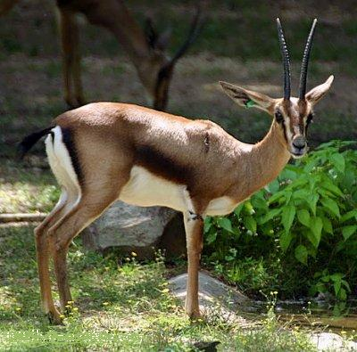
The Care and Feeding of Gazelles
By: Filiberto Calderon and Joseph Partin

Slide 2
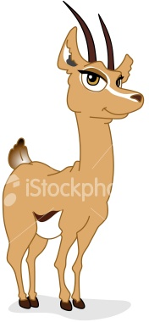
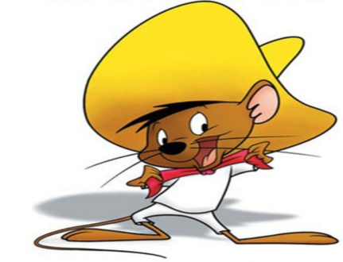
Key Terms to Begin
Gazelles: small groups of high-growth firms that generate most of the new net jobs in the economy.
Mice: small main street businesses that create jobs when they start up but then grow very little.
Elephants: large companies that are often publicly traded, grow slowly, and contribute little to new jobs, however have a large employment share.(high number of employees)

Slide 3
Is it still true? Do small firms create most of the jobs?
David Birch is a renowned economist and president of the research firm Cognetics, Inc.
According to David Birch, small firms are the most important source of job creation.

Slide 4
Is it still true? Do small firms create most of the jobs?
Importance of Small Firms in America’s Economy
Small Firms create over half of all the jobs
1969 to 1976 66% of all new net jobs were created by firms of 20 or fewer employees
1981 to 1985 82% of all new net jobs were created by firms of 20 or fewer employees
2006 Small Firms employed 60.2 million, Large Firms employed 59.7, Firms with fewer than 20 workers employed 21.6 million
Small firms have generated 64% of net new jobs over past 15 years

Slide 5
Is it still true? Do small firms create most of the jobs?
Small Business Act
It was passed by congress in order to aid, counsel, assist, and protect the interests of small businesses
Makes direct loans to small businesses
Guarantees bank loans

Slide 6
Is it still true? Do small firms create most of the jobs?
Other acts:
Small Business Economic Policy Act of 1980
Small Business Job Protection Act of 1996
Small Business Innovation Development Act of 1996
National Small Business Act of 1996

Slide 7
What are the ex ante characteristics that separate gazelles from mice?
Gazelles
Mice
Younger than other firms
Usually smaller than other firms(do not have to be small)
Usually start small
Fast growing business(youth accounts for this)
Double in size
Eventually double again
Create jobs from beginning and continue to offer jobs(also a trait accounted for by youth)
Small main street businesses
Offer jobs at the beginning however availability of jobs declines to very little or none
Slow or no growth rate
Often first businesses to fail due to competition from the gazelles and elephants

Slide 8
What are the ex ante characteristics that separate gazelles from mice?
Gazelles
Mice
Gazelles are high-impact firms
Account for almost all employment and revenue growth in the economy
Fewer than 3 percent of the smallest high-impact firms(gazelles) came into being in the previous four-year period. As firm size increases, however, that rate doubles to over 6 percent
In the first four-year period on 3 percent of high-impact firms(gazelles) die
Mice are low-impact firms and on average do not grow
On average, nearly all job losses are attributed to low-impact firms(mice) with more than 500 employees

Slide 9
What are the ex ante characteristics that separate gazelles from mice?
Unlike mice, gazelles have certain tasks that are necessary for success:
Attracting qualified people for key positions
Retaining key employees(when rapid growth demands new employees and new skills there are often serious tensions between the new employees who start out at competitive wages with defined jobs, and the veterans, who have brought the company to its lofty heights)

Slide 10
Can we identify Gazelles in North Carolina today?
Yes we can. This graph shows that North Carolina has a large amount of Gazelles(high-impact firms).

Slide 11
THE END

